Slide 1
Civic Engagement
Survey Analysis
Naomi Chou, Arielle Davis, Kiana Mohammadinik, Ashish Singh, Matthew Woo
Notes:
Hello Dr. Barrera! To reintroduce ourselves, we are… and we have made our best effort to analyze and organize your survey data for you. We hope you enjoy our presentation. We’d appreciate if you have any questions to save them for the end. Let’s get started.

Slide 2
01
Exploratory Data Analysis
A brief summary of notable data characteristics
Notes:
Let’s begin with a deeper look into what the data represents.

Slide 3
Data Cleaning
Combined the “pre” and “post” data from Winter ‘24 and Spring ‘23
Removing missing values and duplicate responses
Reversing negative scores - Like scale was ordered in an improper direction for some questions
Simplifying labels and question identifiers for easy interpretation
Notes:
Before we could analyze, we first had to prepare the data for simpler interpretation. We began by removing missing and duplicate responses and combining our datasets. We then noticed that some questions had flipped the response label options on the likert scale. Typically in survey construction, 1 is most negative while 5 is most positive. We chose to stick to this methodology. Finally, we simplified unique labels and identifiers.

Slide 4
02
Research Questions
Our Areas of Investigation
Notes:
Now, let’s remind ourselves of the task at hand by clearly stating our research goals for the data.

Slide 5
Our Primary Areas of Investigation
A Year Later
How do the results from the current Winter ‘24 Survey differ from the Spring ‘23 Survey?
Shifting Attitudes
What changes do you see in students’ behaviors toward community engagement before and after their work with their community partners?
Uplifting Community
Did students from various backgrounds experience a gain in knowledge, sense of belonging, and academic confidence after programming.

Slide 6
03
Methods
Our Analytical Approach
Notes:
Now that we defined our research methods, let use elaborate on our process and approach.

Slide 7
Quantitative Evaluation
Linear Mixed-Effect Model
Clustering
Assess what factors affect key responses
Groups data by shared characteristics for interpretation
Notes:
For our quantitative approach, we chose to build linear, mixed effect models to figure out what aspects of a subject might influence their responses. Like does their transfer status raise the probability of selecting a 5 on some questions. Additionally, survey questions with commonalities were categorized into the five following clusters : Academic Confidence, Attitude, Behavior, Knowledge, and Sense of Belonging.

Slide 8
Text Mining
Sentiment
Analysis
NRC
A text mining technique for pattern recognition in unique written responses
A crowd-sourced lexicon of vocabulary classified by emotion
Notes:
For unique, text responses, we opted for sentiment analysis using the NRC lexicon. This allowed us to organize subjects’ free response answers into emotional groupings. These groupings help us see into subjects’ emotions and opinions on course programming.

Slide 9
Limitations
04
Some Obstacles and Areas for Growth
Notes:
Over the course of our project, we did have to acknowledge some limitations at play.

Slide 10

Balancing Subject Demographics
When creating our linear mixed-effects models, certain minority categories were too insignificant to analyze alone. Therefore, we combined categories for easier analysis (Like Ethnicity and Gender).
Notes:
For example, there were only 12 African Americans in the whole dataset of 560 observations. We chose to combine them with the other/multiple ethnicity category. A similar situation occurred with certain gender minorities.

Slide 11

The Problem with Self-Reporting
Social desirability bias and recall bias are some additional factors that may have impacted subject responses, clouding the accuracy of overall conclusions
Notes:
As with many surveys, there are times when subjects are able to identify what they deem to be the “desirable” response. They may choose this over other responses that reflect their true feelings. Additionally recall bias and a slew of other internal factors may have altered subject responses and by proxy, our team’s conclusions.

Slide 12
05
Results
Our Analytical Findings
Notes:
Now let’s move onto our results!

Slide 13
Measures of Overall Gain
Findings from survey response frequencies and variable relationships.
Notes:
We measured the increase and decrease in subject opinion for before and after experiencing civic engagement courses.

Slide 14
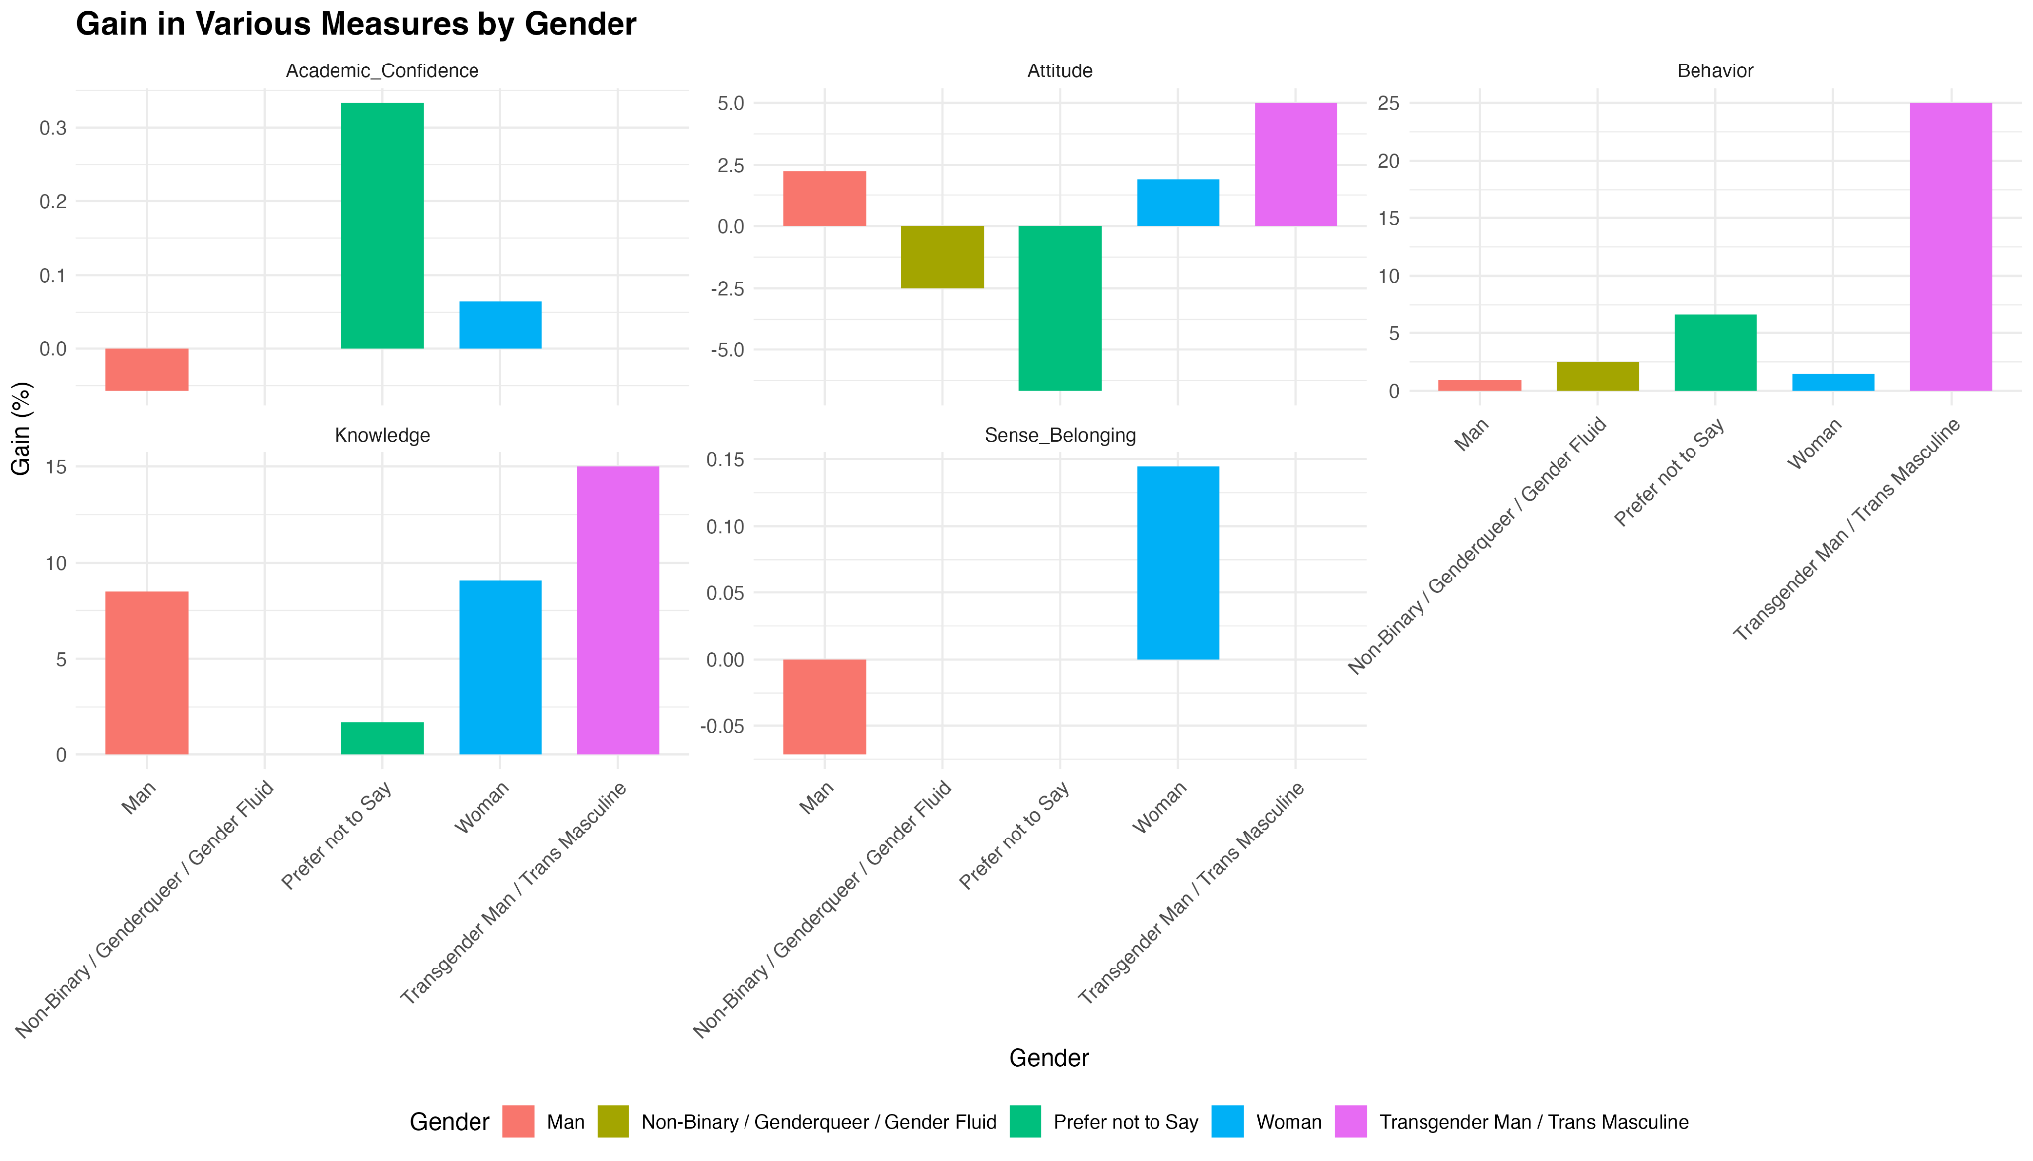
Notes:
On this slide, we can see the gains in various measures by gender, illustrating differences in academic confidence, knowledge, attitude, sense of belonging, and behavior. Notably, Transgender Men/Trans Masculine individuals show the highest gains in knowledge and behavior, while women exhibit significant improvements in academic confidence and knowledge. Additionally, there are notable variations in sense of belonging and attitudes across different gender identities, highlighting the diverse impacts of our programming.

Slide 15
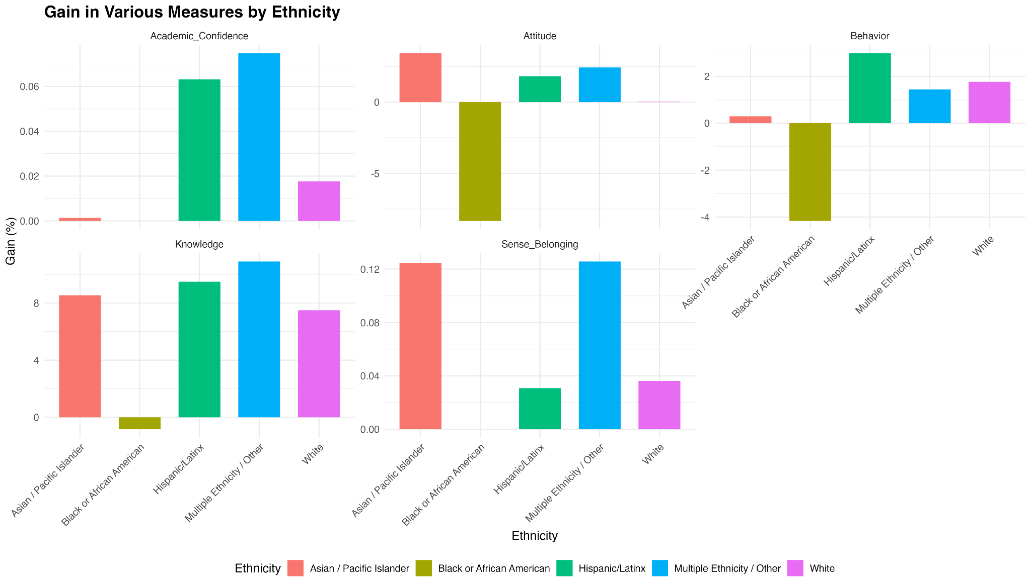
Notes:
This slide shows the gains in various measures by ethnicity. Multiple Ethnicity/Other and Hispanic/Latinx groups show significant gains in knowledge, while Black or African American students exhibit a notable decrease in sense of belonging and attitudes. The graphs illustrate diverse impacts across ethnic groups, with White and Hispanic/Latinx students showing positive gains in several areas."

Slide 16
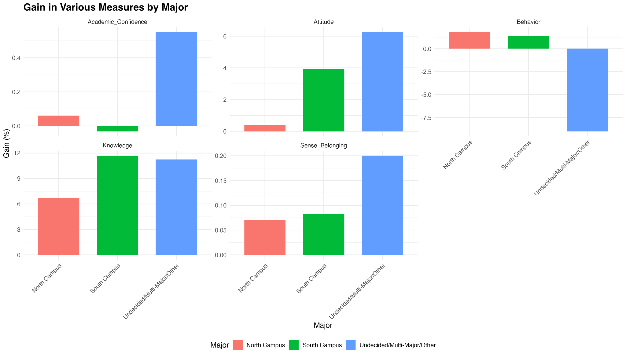
Notes:
This slide displays the gains in various measures by major. South Campus and Undecided/Multi-Major/Other students exhibit significant gains in knowledge, with the latter also showing high improvements in academic confidence and attitude. However, Undecided/Multi-Major/Other students experienced a decrease in behavior scores, indicating varied impacts of the programming across different major groups.

Slide 17
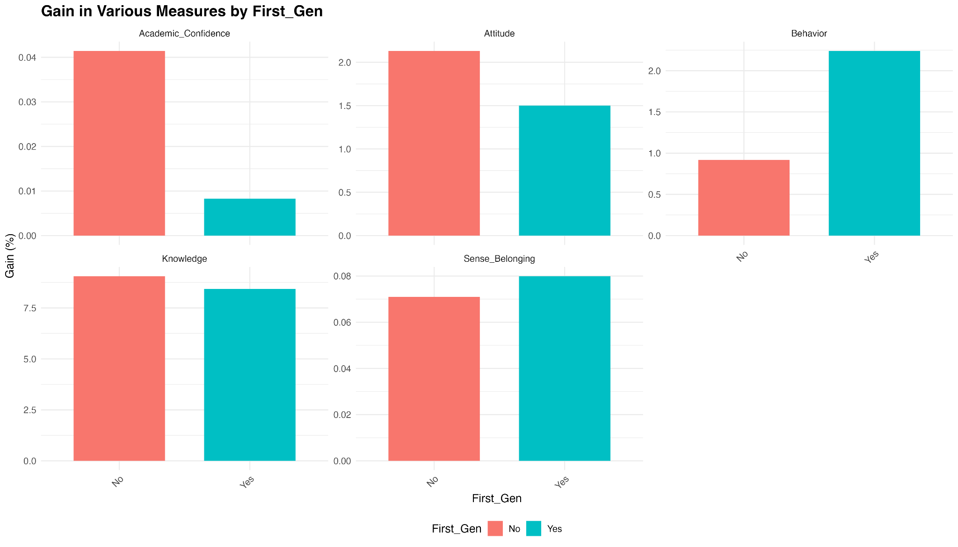
Notes:
This slide illustrates the gains in various measures by first-generation status. First-generation students show higher gains in behavior compared to non-first-generation students. While both groups exhibit similar improvements in knowledge and sense of belonging, non-first-generation students show a slightly higher increase in academic confidence and attitude, highlighting the positive impact of the programming on diverse student backgrounds.

Slide 18
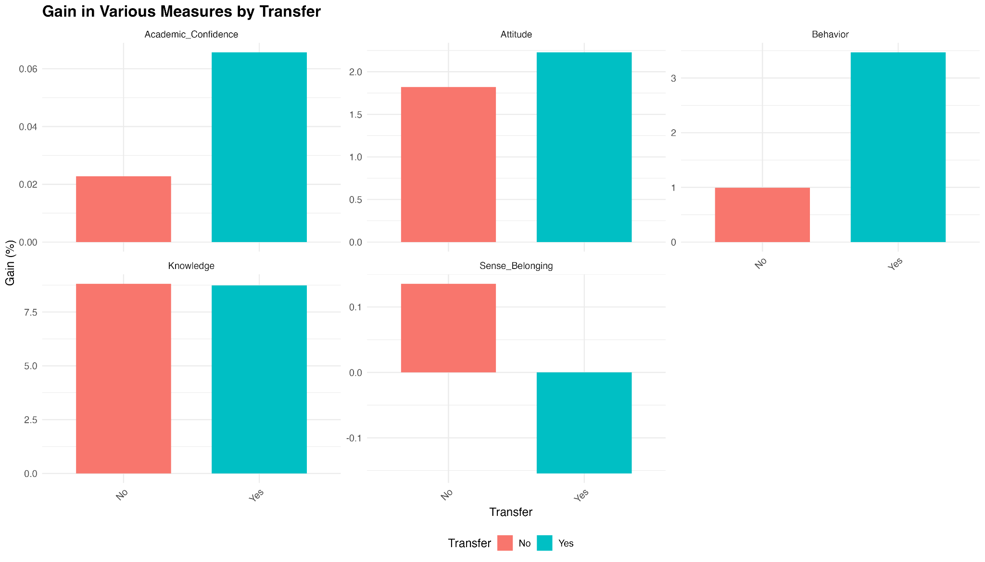
Notes:
This slide presents the gains in various measures by transfer status. Transfer students exhibit higher gains in academic confidence, attitude, and behavior compared to non-transfer students. Both group shows similar improvements in knowledge, while non-transfer students have a slightly higher sense of belongings. These results highlight the positive impact of the programming on transfer students, enhancing their academic and behavioral outcomes.

Slide 19
Linear
Mixed-Effects Models
To assess changes in “knowledge”, “attitude”, “behavior”, and “sense of belonging” while accounting for variability between individual students.
Notes:
Methodology:
The random effect included is the “ID” which allows us to account for variability between students.
We decided that interactions wouldn’t likely be significant and would just end up over complicating the models so we didn’t include them.
The fixed effects that we were interested in are “pre and post”, “Ethnicity”, “Gender”, and “North campus vs South campus”.
We analyzed their effects on the “knowledge”, “attitude”, and “behavior” clusters and also on students’ “sense of belonging”.

Slide 20
Knowledge Model
• Pre/Post: The post-class scores are significantly higher by 8.76 points (p< 2e − 16).
• Ethnicity: Compared to the baseline (likely Asian / Pacific Islander):
– Hispanic/Latinx: Not significantly different (p = 0.695).
– Multiple Ethnicity / Other: Not significantly different (p = 0.266).
– White: Significantly higher by 4.38 points (p = 0.015).
• Gender: Women have significantly higher scores by 4.08 points (p = 0.003).
• North vs South Campus: Students from the South Campus have significantly lower scores by 3.34 points (p = 0.008).
Notes:
P-values are added here because generally the threshold for statistical significance is a p-value less than 0.05

Slide 21
Attitude Model
• Pre/Post: The post-class scores are significantly higher by 1.97 points (p = 0.008).
• Ethnicity: Compared to the baseline (likely Asian / Pacific Islander):
– Hispanic/Latinx: Not significantly different (p = 0.318).
– Multiple Ethnicity / Other: Not significantly different (p = 0.517).
– White: Marginally higher by 3.50 points but still not significantly different (p = 0.067).
• Gender: Women have significantly higher scores by 7.41 points (p = 1.02e − 06).
• North vs South Campus: Not significantly different (p = 0.117).

Slide 22
Behavior Model
• Pre/Post: The post-class scores are marginally higher by 1.49 points (p = 0.058).
• Ethnicity: Compared to the baseline (likely Asian / Pacific Islander):
– Hispanic/Latinx: Marginally higher by 2.97 points (p = 0.080).
– Multiple Ethnicity / Other: Significantly higher by 4.80 points (p = 0.013).
– White: Significantly higher by 8.86 points (p = 5.21e − 06).
• Gender: Women have significantly higher scores by 4.42 points (p = 0.003).
• North vs South Campus: Not significantly different (p = 0.316).

Slide 23
Sense of Belonging Model
• Pre/Post: The post-class scores are marginally higher by 0.06 points (p = 0.090).
• Ethnicity: Compared to the baseline (likely Asian / Pacific Islander):
– Hispanic/Latinx: Significantly lower by 0.20 points (p = 0.026).
– Multiple Ethnicity / Other: Not significantly different (p = 0.972).
– White: Marginally higher by 0.18 points (p = 0.076).
• Gender: Not significantly different (p = 0.796).
• North vs South Campus: Not significantly different (p = 0.879).

Slide 24
Summary of Findings:
The civics study class has a marginally positive effect on Attitude, and Behavior scores, but the reported gains are particularly significant for Knowledge.
Gender differences are notable, with women showing higher improvements across Knowledge, Attitude, and Behavior.
Ethnicity differences suggest that White students reported more in gain of Knowledge and Behavior, while Hispanic/Latinx students show a decrease in Sense of Belonging.
South vs North campus didn’t have much of a significant effect on any category except for “Knowledge” gain for which students from South Campus have reported significantly lower scores than students from the North Campus.

Slide 25
Survey Sentiments
Findings from Text Mining that gauge subject’s opinions and feelings using NRC format.
Notes:
This slide presents findings from text mining that gauge students' opinions and feelings using NRC sentiment analysis. We examined student sentiments before and after taking the courses, noting subtle changes in their experiences.

Slide 26
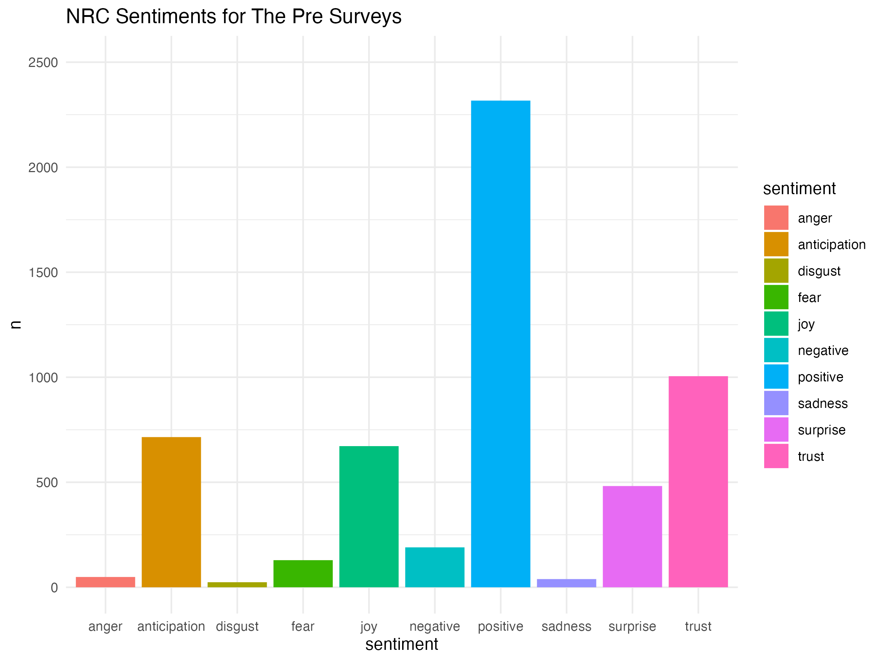
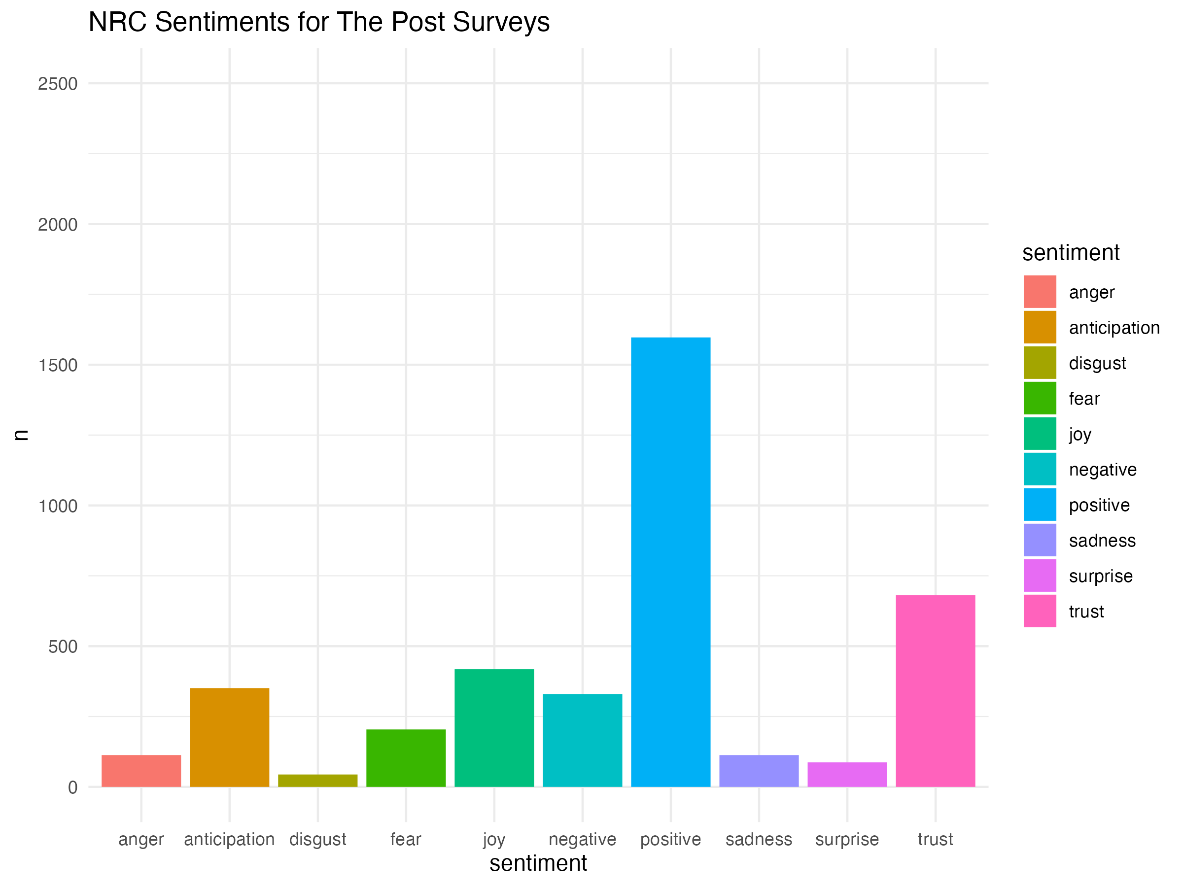
NRC Pre vs Post
Student sentiments before and after taking the courses.
Some changes indicating subtle changes about their experiences.
Notes:
This slide compares NRC sentiments for pre and post surveys, showing student sentiments before and after taking the courses. Notable changes include an increase in positive and trust sentiments after the courses, while negative sentiments have decreased.

Slide 27
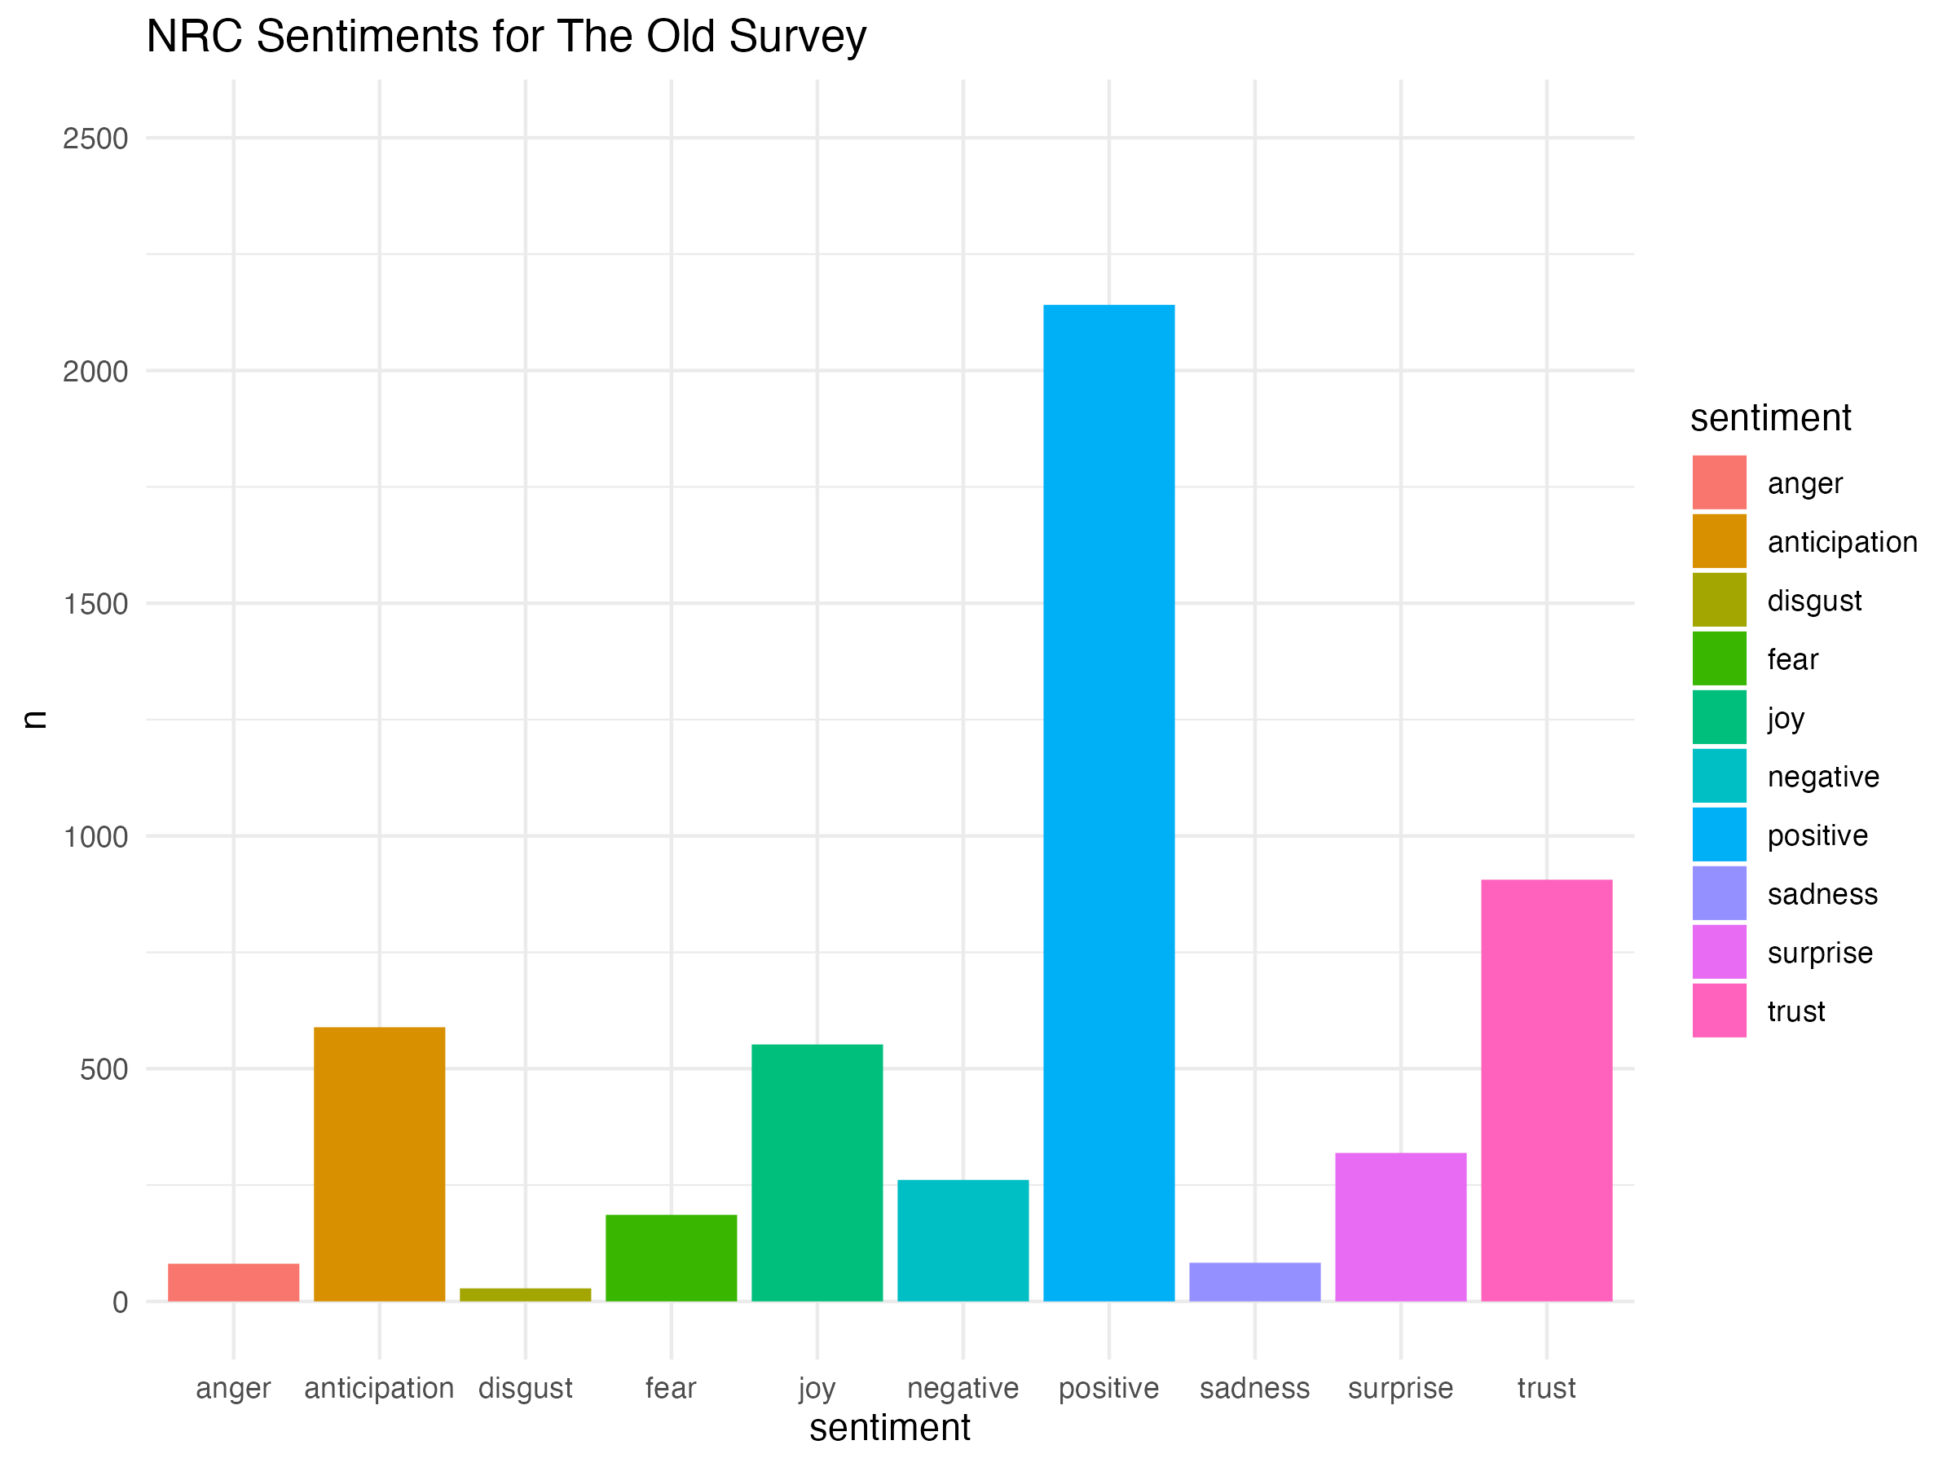
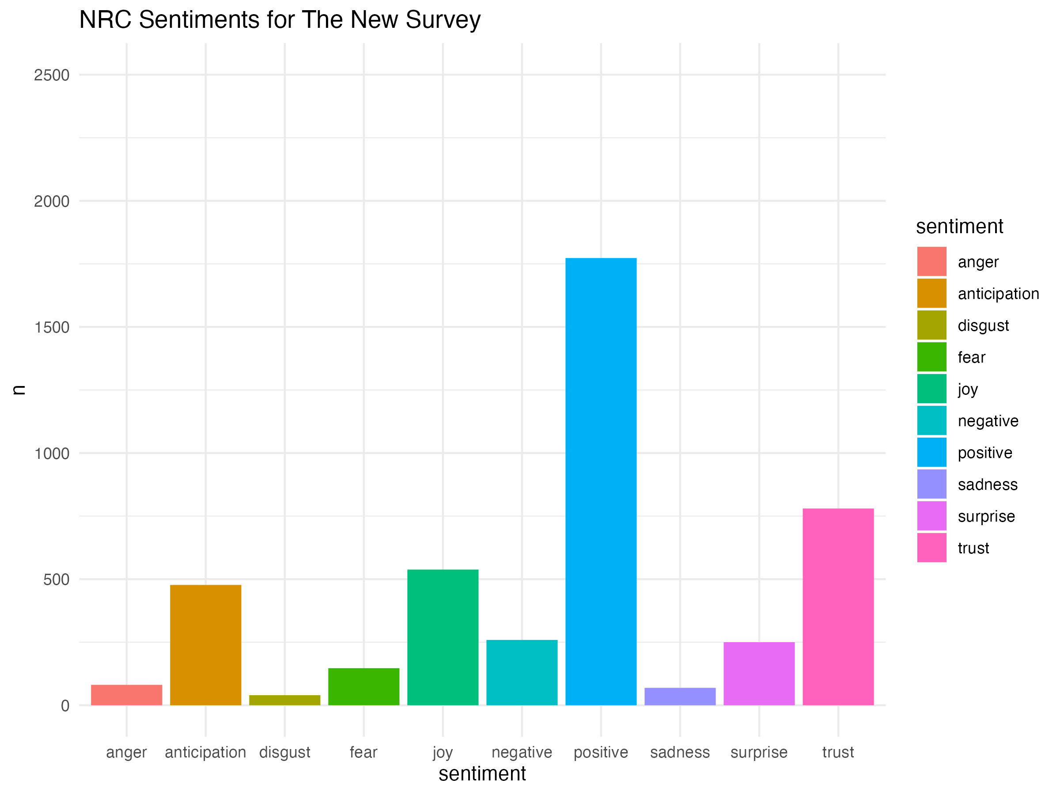
NRC Old vs New
Students from the recent quarter had the same sentiments towards the courses as those from the previous quarter
This visual shows that these courses are consistent.
Notes:
This slide compares NRC sentiments between old and new surveys, showing that student sentiments towards the courses remain consistent across different quarters. Both the old and new survey results reflect similar patterns, indicating the stability and reliability of the courses in delivering consistent experiences for students.

Slide 28
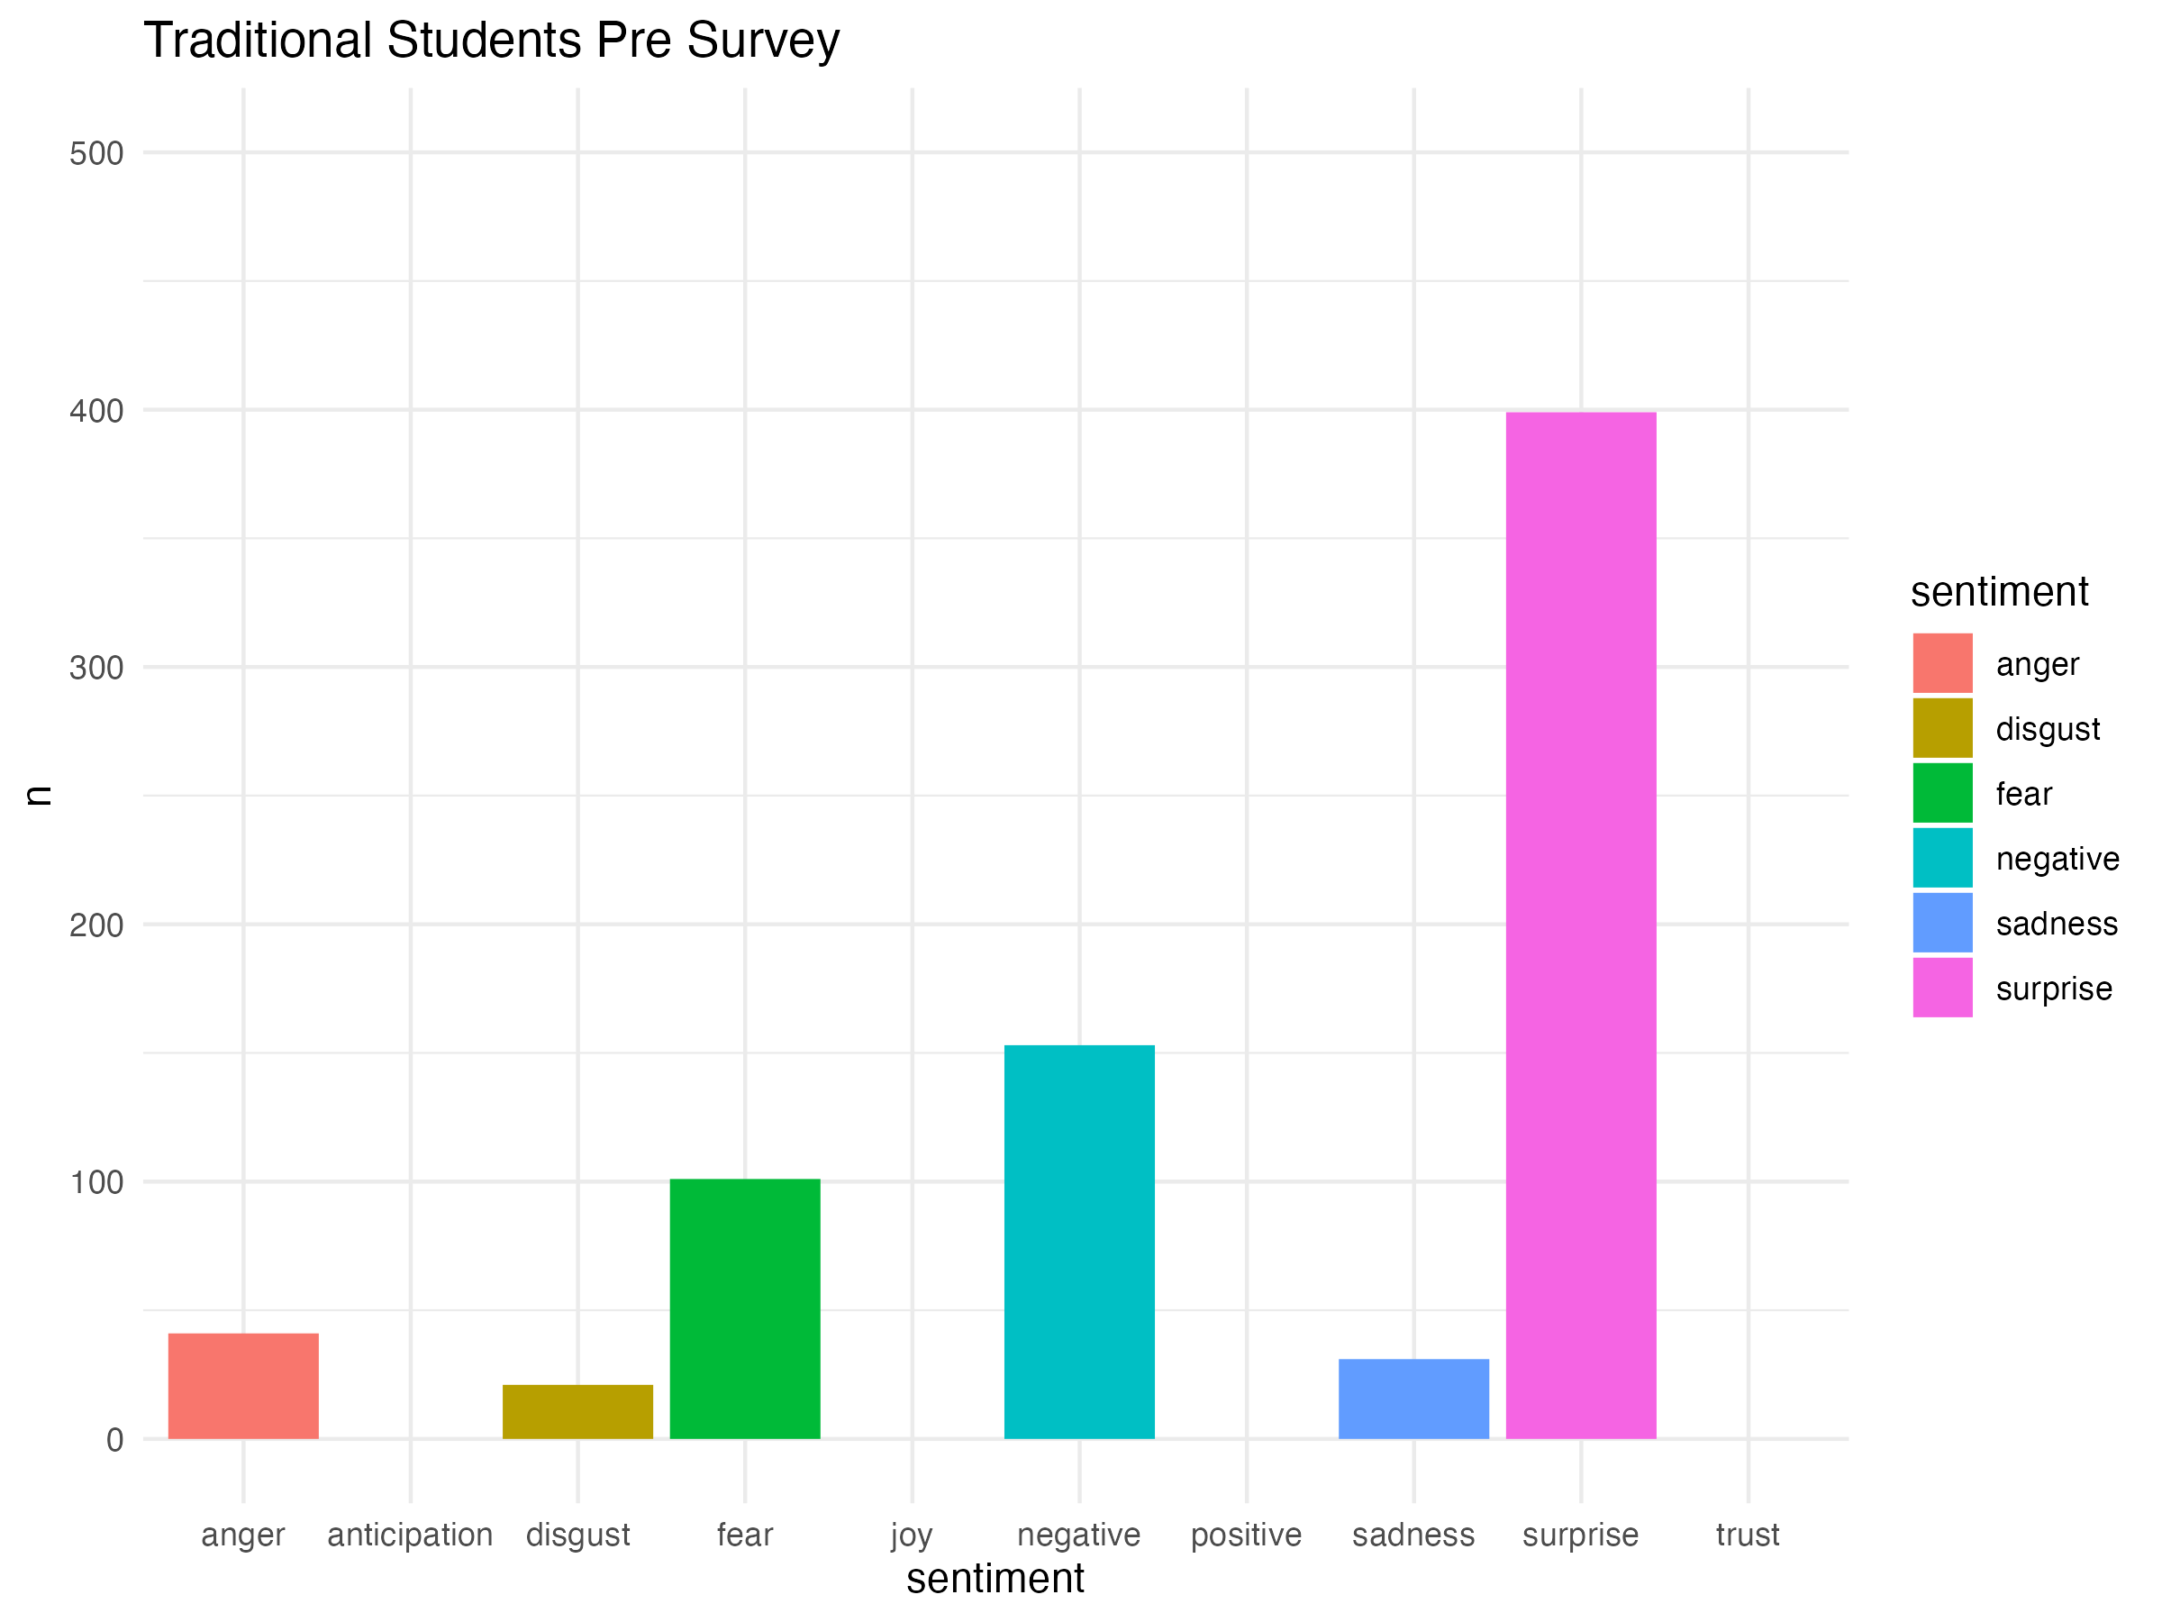
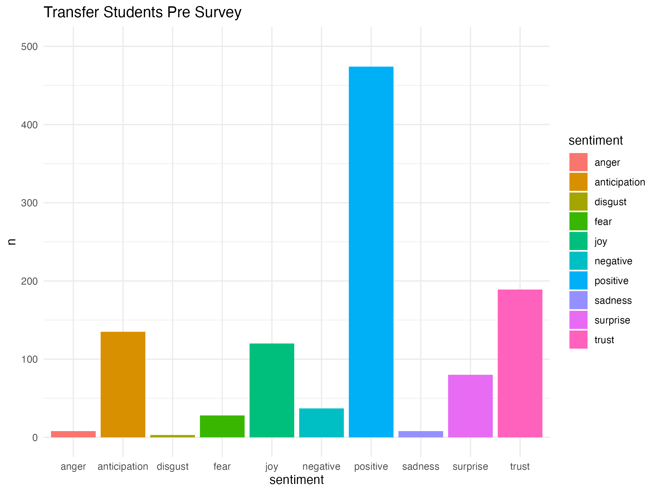
NRC Traditional vs Transfer
There is significant changes in the sentiments between the traditional and transfer plots
Emotions such as surprise, trust, positive, joy, and anticipation show significant differences.
Notes:
This slide highlights the significant differences in sentiments between traditional and transfer students. Emotions such as surprise, trust, positive, joy, and anticipation show notable variations. These graphs indicate that transfer students experience higher levels of positive and trust sentiments, while traditional students exhibit more surprise and sadness, reflecting their differing experiences and perceptions.

Slide 29
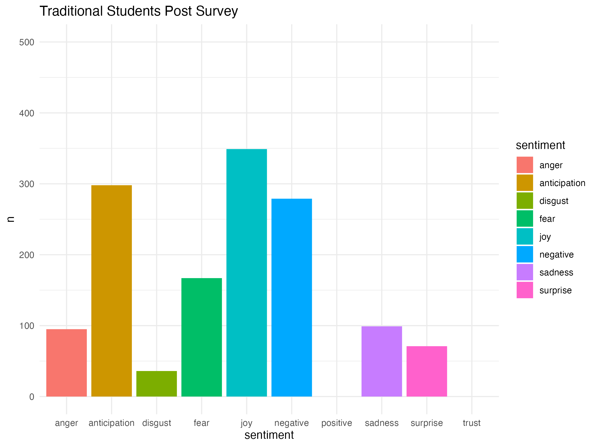
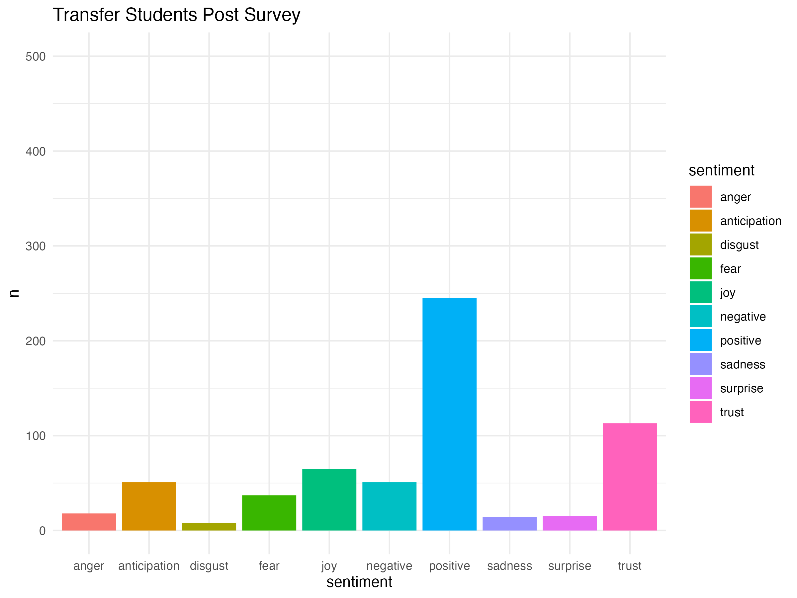
NRC Traditional vs Transfer Cont.
Supporting the previous slide we see there are major differences between the two plots.
In this situation we see the change with practically every emotion.
Notes:
This slide continues to compare NRC sentiments between traditional and transfer students, showing major differences in post-survey emotions. Practically every emotion demonstrates a change, with traditional students showing higher levels of joy and negative sentiments, while transfer students exhibit more positive and trust sentiments.

Slide 30
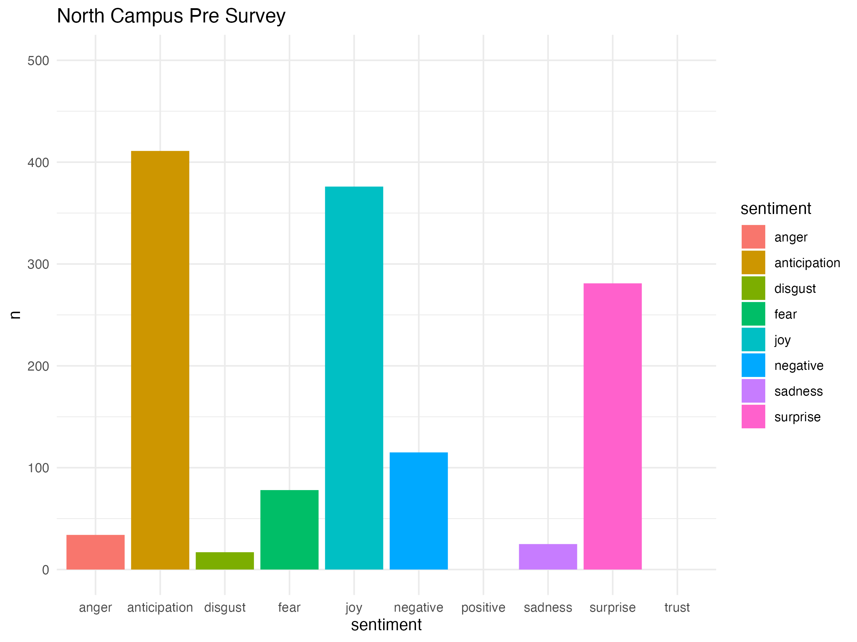
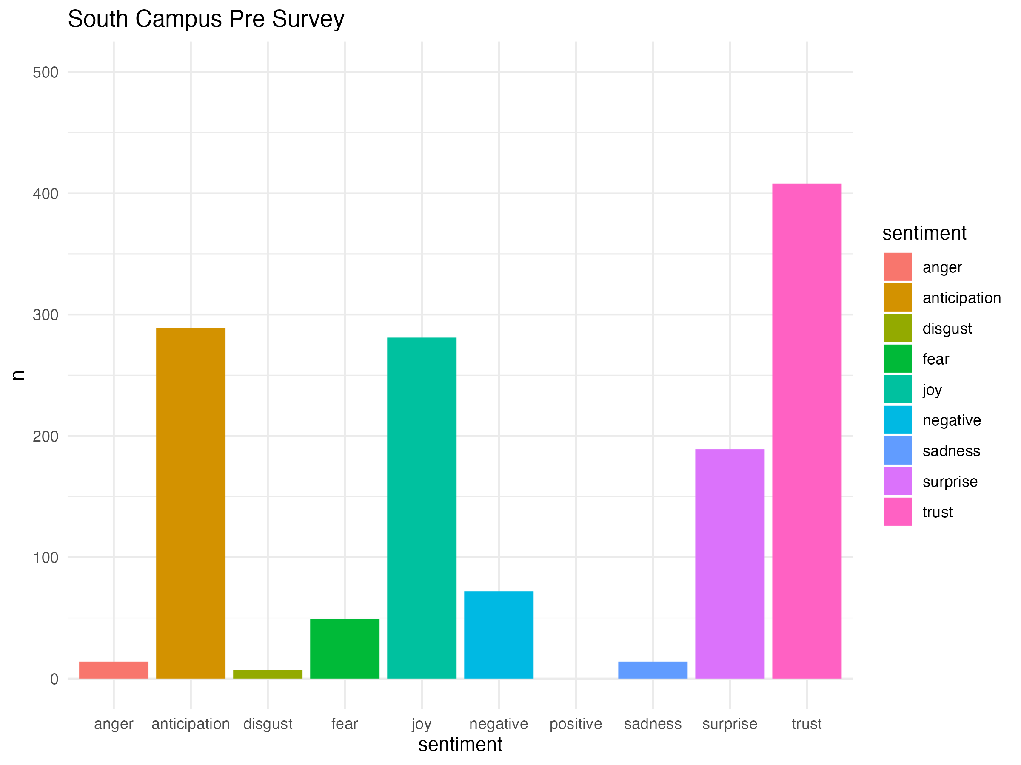
NRC North vs South
These plots indicate that there is only significant change, however, only with certain emotions
With surprise and trust, we see a change in the pattern of sentiments.
Notes:
This slide compares NRC sentiments between North and South campus students. While most emotions show similar patterns, there are significant changes in specific emotions like surprise and trust. North Campus students exhibit higher anticipation and joy, whereas South Campus students show more sadness and trust, indicating distinct emotional responses between the two groups.

Slide 31
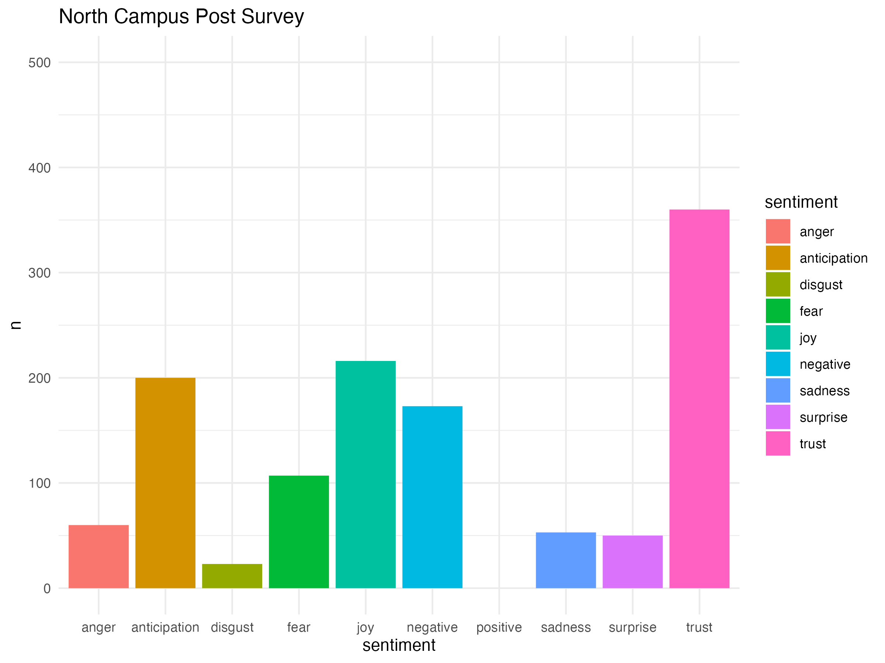
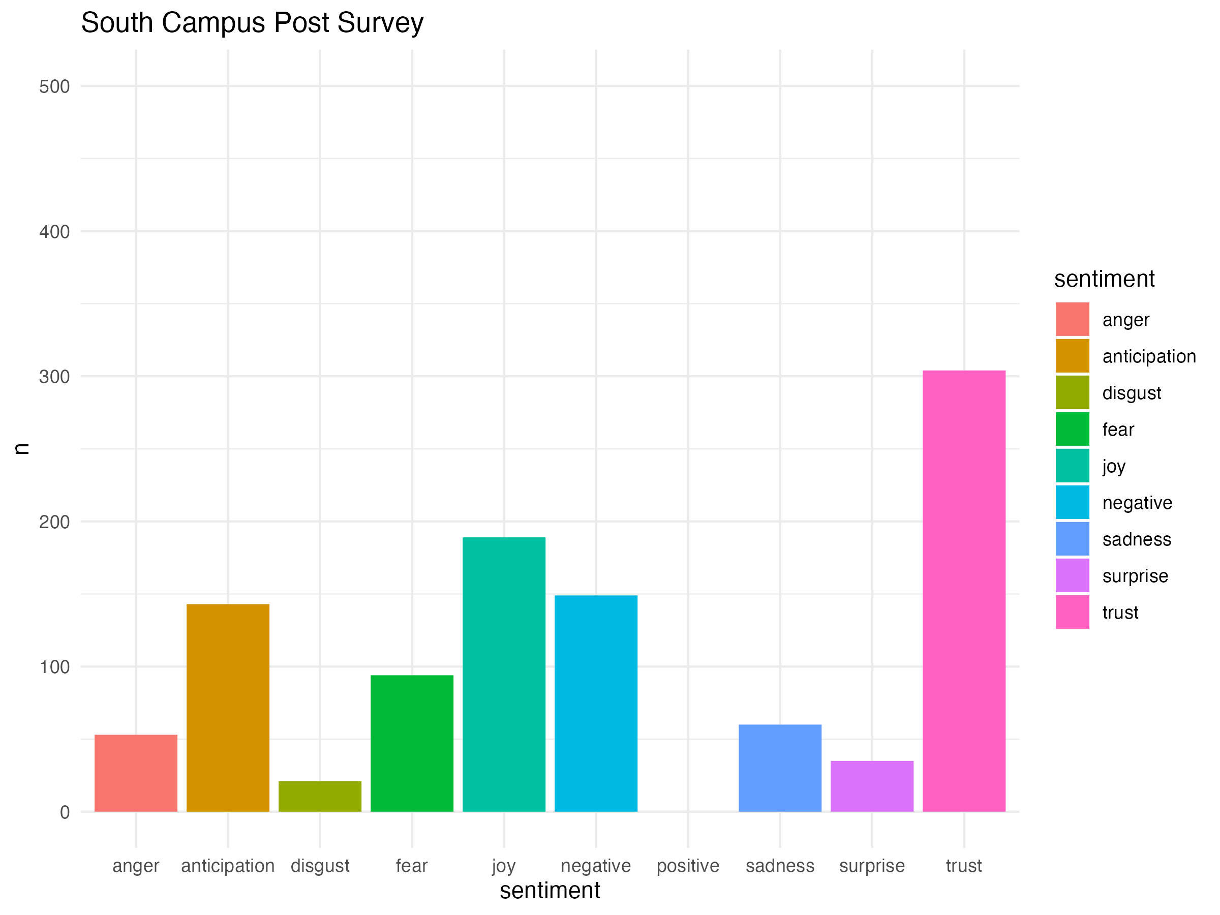
NRC North vs South Cont.
These plots contradict the previous slide showing that there is no significant difference between North and South campus majors.
These plots indicate positive engagement between the two groups.
Notes:
This slide continues the comparison of NRC sentiments between North and South campus students, post-survey. Contrary to the previous slide, these plots show no significant differences between the two groups, indicating positive engagement across both campuses. The similarity in sentiment patterns suggests a consistent experience of the courses for students from both campuses.

Slide 32
06
Final Thoughts
Notes:
Finally, let’s move onto our final part, conclusion

Slide 33
Key Takeaways
Significant results between traditional/transfer and North/South suggest that changes may be required in the courses to improve civic engagement
Implementing targeted interventions based on our findings can improve student knowledge, attitudes, and behaviors.
Consistent positive feedback across different survey periods indicates a strong foundational elements of the courses, suggesting that building upon these can further improve the student engagement.
Moving Forward
Utilize our findings to enhance the survey allowing future Data Analysts/scientists to continue research
Continuously update the civic engagement programming to ensure it remains relevant and capable of fostering a more engaged and informed student body.
Develop strategies that can also support the underrepresented and minority groups to advance the inclusivity.

Slide 34
Thanks!
Please keep this slide for attribution

